Slide 1
MODULE II
B.Tech. CSE
Semester VI
Viswajyothi College of Engineering

Slide 2
Syllabus
Creating & using classes in Java
  Methods and Classes
Inheritance
  Super Class
  Method Overriding
Packages and Interfaces
  Implementing Interfaces
Exception Handling
  Exception Types
Threads
  Multithreaded programs
    Thread Priorities
    Thread synchronization

Slide 3
Creating and Using Classes in Java
Syntax of Class :
class classname
{
type instance-variable1;
type instance-variable2;
// ...
type instance-variableN;
type methodname1(parameter-list)
{ // body of method }
type methodname2(parameter-list)
{ // body of method }
// ...
type methodnameN(parameter-list)
{ // body of method }
}

Slide 4
Creating and Using Classes in Java
Class defines a new data type.
Once defined, it can be used to create objects of that type.
A class is a template for an object, and an object is an instance of a class.
The methods and variables defined within a class are called members of the class.
The variables, defined within a class are called instance variables. The data for one object is separate and unique from the data for another.
The code is contained within methods.

Slide 5
Creating and Using Classes in Java
Example: Define a class Box which defines three instance variables: width, height, and depth.
class Box
{
double width;
double height;
double depth;
}
This class defines a new data type called Box

Slide 6
Declaring a class Object
Two-step process :
  Declare a variable of the class type
  Acquire an actual, physical copy of the object and assign it to that variable. This can be done using the new operator. new allocates memory for an object during run time.
Example :
Box mybox; // declare reference to object
mybox = new Box(); // allocate a Box object
The above statements can also be written as follows
Box mybox = new Box();

Slide 7
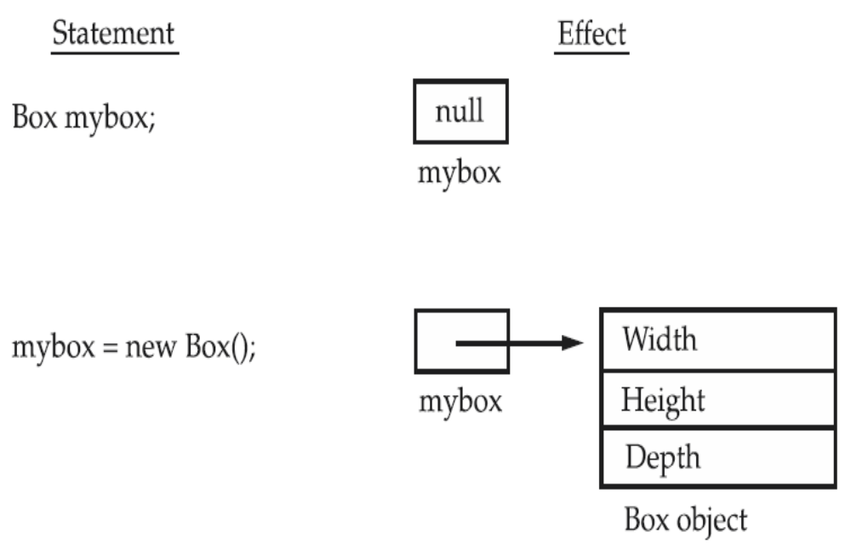
Declaring a class Object

Slide 8
Declaring a class Object
To access these variables, we will use the dot (.) operator.
Example : assign the width variable of mybox the value 100
mybox.width = 100;
If we have two Box objects, each has its own copy of depth, width, and height. Changes to the instance variables of one object have no effect on the instance variables of another
Write a program to find the volume of a box, whose dimensions are given

Slide 9
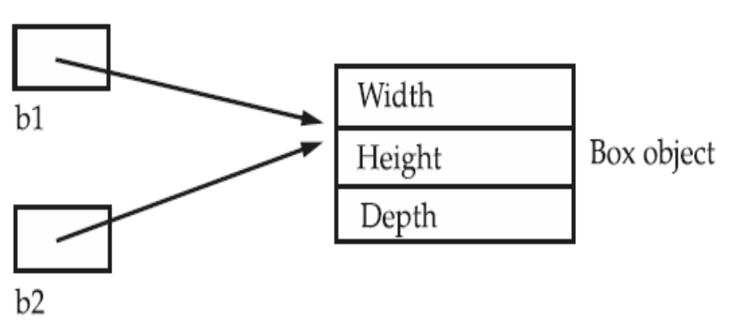
Assigning Object Reference Variables
Example:
Box b1 = new Box();
Box b2 = b1;
A subsequent assignment to b1 will simply unhook b1 from the original object without affecting the object or affecting b2.
Example: Box b1 = new Box();
Box b2 = b1;
// ...
b1 = null;
Here, b1 has been set to null, but b2 still points to the original object.

Slide 10
Methods
Syntax : type name(parameter-list)
{
// body of method
}
Methods that have a return type other than void return a value to the calling routine
  Syntax : return value;
  The type of data returned by a method must be compatible with the return type specified by the method.
  The variable receiving the value returned by a method must also be compatible with the return type specified for the method.
The name of the method should be a legal identifier

Slide 11
Methods
Write a program to find the volume of a box (whose dimensions are given) using method.
Write a program to find the volume of a box using parameterized method.

Slide 12
Constructors
Used to initialize objects when they are created.
It has the same name as the class in which it resides
It is syntactically similar to a method.
The constructor is automatically called immediately after the object is created.
Constructors have no return type.
Parameterized Constructor : A constructor which having parameter is called parameterized constructor.
Write a program to find the volume of a box using constructor
Write a program to find the volume of a box using parameterized constructor

Slide 13
this Keyword
this keyword can be used inside any method to refer to the current object.
Example :
  Box(double w, double h, double d)
  {
  this.width = w;
  this.height = h;
  this.depth = d;
  }
  Here the use of this is redundant

Slide 14
this Keyword
this can be used to resolve any name space collisions that might occur between instance variables and local variables.
Example :
  Box(double width, double height, double depth)
  {
  this.width = width;
  this.height = height;
  this.depth = depth;
  }

Slide 15
Garbage Collection
Java handles deallocation of objects automatically.
The technique that accomplishes this is called garbage collection.
When no references to an object exist, that object is assumed to be no longer needed, and the memory occupied by the object can be reclaimed.
Garbage collection only occurs infrequently during the execution of the program.

Slide 16
finalize() method
Sometimes an object will need to perform some action when it is destroyed. Java provides a finalization mechanism to handle such situations.
  Define the finalize( ) method.
  Specify those actions that must be performed before an object is destroyed
finalize( ) is only called just prior to garbage collection.
General form:
  protected void finalize( )
  {
  // finalization code here
  }

Slide 17
Method Overloading
In Java it is possible to define two or more methods within the same class that share the same name, as long as their parameter declarations are different. This is called method overloading.
Method overloading is one of the ways that Java implements polymorphism.
When an overloaded method is invoked, Java uses the type and/or number of arguments as its guide to determine which version of the overloaded method to actually call
Java will employ automatic type conversions if no exact match is found
Write a program to display an character, integer number and a floating point number using the concept method overloading

Slide 18
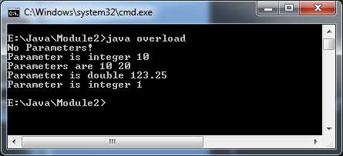
class overload
{
public static void main(String args[])
{
overloaddemo o=new overloaddemo();
byte b=1;
o.test();
o.test(10);
o.test(10,20);
o.test(123.25);
o.test(b);
}}
class overloaddemo
{
void test()
{
System.out.println("No Parameters!");
}
void test(int a)
{
System.out.println("Parameter is "+a);
}
void test(int a,int b)
{
System.out.println("Parameters are "+a+ " "+b);
}
void test(double a)
{
System.out.println("Parameter is double "+a);
}
}

Slide 19
Constructor Overloading
Constructor methods can also be overloaded
class Box { double width, height,depth; Box(double w, double h, double d) { width = w; height = h; depth = d; } Box() { width = -1; height = -1; depth = -1; } Box(double len) { width = height = depth = len; } double volume() { return width * height * depth; } }
class OverloadCons { public static void main(String args[]) { Box mybox1 = new Box(10, 20, 15); Box mybox2 = new Box(); Box mycube = new Box(7); double vol; vol = mybox1.volume(); System.out.println("Volume of mybox1 is " + vol); vol = mybox2.volume(); System.out.println("Volume of mybox2 is " + vol); vol = mycube.volume(); System.out.println("Volume of mycube is " + vol); } } O/p: Volume of mybox1 is 3000.0 Volume of mybox2 is -1.0 Volume of mycube is 343

Slide 20
Using Objects as Parameter
An object can also be passed to methods as arguments
An object an also be used to initialize another object
class Test { int a, b; Test(int i, int j) { a = i; b = j; } boolean equals(Test o) { if(o.a == a && o.b == b) return true; else return false; } }
class PassOb { public static void main(String args[]) { Test ob1 = new Test(100, 22); Test ob2 = new Test(100, 22); Test ob3 = new Test(-1, -1); System.out.println("ob1 == ob2: " + ob1.equals(ob2)); System.out.println("ob1 == ob3: " + ob1.equals(ob3)); } }

Slide 21
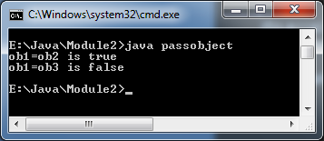

Slide 22
Returning Objects
A method can return objects
class Test { int a; Test(int i) { a = i; } Test incrByTen() { Test temp = new Test(a+10); return temp; } }
class RetOb { public static void main(String args[]) { Test ob1 = new Test(2); Test ob2; ob2 = ob1.incrByTen(); System.out.println("ob1.a: " + ob1.a); System.out.println("ob2.a: " + ob2.a); ob2 = ob2.incrByTen(); System.out.println("ob2.a after second increase: " + ob2.a); } }

Slide 23
Output
ob1.a: 2
ob2.a: 12
ob2.a after second increase: 22

Slide 24
Argument Passing
Two ways to pass an argument to a method :
  call-by-value
  call-by-reference
When a simple type is passed to a method, it is done by use of call-by-value. Objects are passed by use of call-by-reference

Slide 25
Argument Passing – pass by value
class Test { void meth(int i, int j) { i *= 2; j /= 2; } } class CallByValue { public static void main(String args[]) { Test ob = new Test(); int a = 15, b = 20; System.out.println("a and b before call: " + a + " " + b); ob.meth(a, b); System.out.println("a and b after call: " + a + " " + b); } }

Slide 26
Argument Passing – pass by reference
class Test { int a, b; Test(int i, int j) { a = i; b = j; } void meth(Test o) { o.a *= 2; o.b /= 2; } } class CallByRef { public static void main(String args[]) { Test ob = new Test(15, 20); System.out.println("ob.a and ob.b before call: " + ob.a + " " + ob.b); ob.meth(ob); System.out.println("ob.a and ob.b after call: " + ob.a + " " + ob.b); } }

Slide 27
Recursion
Recursion is the process of defining something in terms of itself
A method that calls itself is said to be recursive
When a method calls itself, new local variables and parameters are allocated storage on the stack, and the method code is executed with these new variables from the start.
As each recursive call returns, the old local variables and parameters are removed from the stack, and execution resumes at the point of the call inside the method.
Write a program to compute the factorial of a number using recursion.

Slide 28
class recursion
{
int fact(int n)
{
if(n==1)
return 1;
else
return fact(n-1)*n;
}
}

Slide 29
class rec
{
public static void main(String args[])
{
int n=5;
recursion r=new recursion();
System.out.println(r.fact(n));
}
}

Slide 30
Recursion
Disadvantages :
  Recursive routines are slower than the iterative routines
  Many recursive calls to a method could cause a stack overrun.
Advantage:
  Recursive methods can be used to create clearer and simpler versions of several algorithms than their iterative equivalent.
  Some problems, especially AI-related ones, seem to lend themselves to recursive solutions.

Slide 31
Access Control
Access specifiers in Java are :
  Public : This member can be accessed by any other code
  Private : This member can only be accessed by other members of its class.
  Protected : protected applies only when inheritance is involved.
When no access specifier is used, then by default the member of a class is public within its own package, but cannot be accessed outside of its package.

Slide 32
class Test { int a; public int b; private int c; void setc(int i) { c = i; } int getc() { return c; } }
class AccessTest { public static void main(String args[]) { Test ob = new Test(); // These are OK, a and b may be accessed directly ob.a = 10; ob.b = 20; // This is not OK and will cause an error // ob.c = 100; // Error! // You must access c through its methods ob.setc(100); // OK System.out.println("a, b, and c: " + ob.a + " " + ob.b + " " + ob.getc()); } }

Slide 33
Static
When a member is declared static, it can be accessed before any objects of its class are created, and without reference to any object.
Example : main( )
Both methods and variables can be declared as static.
Example : static int i;
static void add(){ ……. }
Instance variables declared as static are, essentially, global variables
When objects of its class are declared, no copy of a static variable is made. Instead, all instances of the class share the same static variable

Slide 34
Static
Properties of static Methods :
  They can only call other static methods.
  They must only access static data.
  They cannot refer to this or super in any way.
Syntax for calling static methods and variables from outside of the class is : classname.method( )
Static block : It is defined inside a class to initialize static variables, which gets executed exactly once, when the class is first loaded.
Syntax : static
{
…………
}

Slide 35
class StaticDemo { static int a = 42; static int b ; static { b=a*2; } static void callme() { System.out.println("a = " + a); } } class StaticByName { public static void main(String args[]) { StaticDemo.callme(); System.out.println("b = " + StaticDemo.b); } }

Slide 36
final Variables
Final variables prevents its contents from further modification.
Must initialize a final variable when it is declared.
Example:
  final int FILE_NEW = 1;
  final int FILE_OPEN = 2;
These values can not be changed during execution.
Variables declared as final do not occupy memory on a per-instance basis.

Slide 37
Nested Classes and Inner Classes
A class within another class is known as nested class.
A nested class has access to the members, including private members, of the class in which it is nested.
The enclosing class does not have access to the members of the nested class.
There are two types of nested classes:
  Static :
    static modifier is used.
    Access the members of its enclosing class through an object.
  Non-static (inner class) :
    It is a non-static nested class.
    It has access to all of the variables and methods of its outer class and may refer to them directly in the same way that other non-static members of the outer class do.
Nested class can also be defined within the block defined by a method or even within the body of a for loop

Slide 38
class Outer { int outer_x = 100; void test() { Inner inner = new Inner(); inner.display(); } class Inner { void display() { System.out.println("display: outer_x = " + outer_x); } } } class InnerClassDemo { public static void main(String args[]) { Outer outer = new Outer(); outer.test(); } }

Slide 39
// This program will not compile. class Outer { int outer_x = 100; void test() { Inner inner = new Inner(); inner.display(); } class Inner { int y = 10; // y is local to Inner void display() { System.out.println("display: outer_x = " + outer_x); } } void showy() { System.out.println(y); // error, y not known here! } } class InnerClassDemo { public static void main(String args[]) { Outer outer = new Outer(); outer.test(); } }

Slide 40
String Class
String is class in Java’s class library
Even string constants are String objects.
Example: System.out.println("This is a String, too");
Once a String object is created, its contents cannot be altered.
String construction : String myString = "this is a test";
Once we have created a String objects can be used anywhere that a string is allowed.
Example: System.out.println(myString);
+ operator is used to concatenate two strings.
Example: String myString = "I" + " like " + "Java.";

Slide 41
class StringDemo { public static void main(String args[]) { String strOb1 = "First String"; String strOb2 = "Second String"; String strOb3 = strOb1 + " and " + strOb2; System.out.println(strOb1); System.out.println(strOb2); System.out.println(strOb3); } }

Slide 42
String Class
The String class contains several methods
  equals( ) -- test two strings are equal
  boolean equals(String object)
  length( ) -- obtain the length of a string
  int length( )
  charAt( ) -- obtain the character at a specified index
  char charAt(int index)

Slide 43
class StringDemo2 { public static void main(String args[]) { String strOb1 = "First String"; String strOb2 = "Second String"; String strOb3 = strOb1; System.out.println("Length of strOb1: " + strOb1.length()); System.out.println("Char at index 3 in strOb1: " + strOb1.charAt(3)); if(strOb1.equals(strOb2)) System.out.println("strOb1 == strOb2"); else System.out.println("strOb1 != strOb2"); if(strOb1.equals(strOb3)) System.out.println("strOb1 == strOb3"); else System.out.println("strOb1 != strOb3"); } }

Slide 44
String Class
String array is also possible
class StringDemo3 { public static void main(String args[]) { String str[] = { "one", "two", "three" }; for(int i=0; i<str.length; i++) System.out.println("str[" + i + "]: " + str[i]); } }

Slide 45
Command-Line Arguments
To pass information into a program when it runs
A command-line argument is the information that directly follows the program’s name on the command line when it is executed.
Command-line arguments are stored as strings in the String array passed to main( ).
class CommandLine { public static void main(String args[]) { for(int i=0; i<args.length; i++) System.out.println("args[" + i + "]: " + args[i]); } }

Slide 46
Arrays
Arrays are implemented as objects.
The size of an array is found in its length instance variable.
class Length { public static void main(String args[]) { int a1[] = new int[10]; int a2[] = {3, 5, 7, 1, 8, 99, 44, -10}; int a3[] = {4, 3, 2, 1}; System.out.println("length of a1 is " + a1.length); System.out.println("length of a2 is " + a2.length); System.out.println("length of a3 is " + a3.length); } }

Slide 47
Syllabus
Creating & using classes in Java
  Methods and Classes
Inheritance
  Super Class
  Method Overriding
Packages and Interfaces
  Implementing Interfaces
Exception Handling
  Exception Types
Threads
  Multithreaded programs
    Thread Priorities
    Thread synchronization

Slide 48
Inheritance
The mechanism of deriving a new class from old class is called Inheritance.
The old class is known as the base class(or super class or parent class)
The new one is called the subclass (or derived class or child class).
  A subclass is a specialized version of a superclass.
  It inherits all of the instance variables and methods defined by the superclass and adds its own, unique elements.
General form :
class subclass-name extends superclass-name
{
// body of class
}

Slide 49
class A { int i, j; void showij() { System.out.println("i and j: " +i+ “ “ +j); } } class B extends A { int k; void showk() { System.out.println("k: " + k); } void sum() { System.out.println("i+j+k: " + (i+j+k)); } }
class SimpleInheritance { public static void main(String args[]) { A superOb = new A(); B subOb = new B(); superOb.i = 10; superOb.j = 20; superOb.showij(); System.out.println(); subOb.i = 7; subOb.j = 8; subOb.k = 9; subOb.showij(); subOb.showk(); System.out.println(); subOb.sum(); } }

Slide 50
Output
i and j: 10 20
i and j: 7 8
k:9
i+j+k:24

Slide 51
Inheritance
Different types of Inheritance :
  Single Inheritance:
    Only one super class
  Multiple Inheritance :
    Several super classes for a single sub class.
    Java does not directly support this type of inheritance. This inheritance is implemented by using the concept of interfaces.
  Hierarchical Inheritance :
    One super class, many subclasses
  Multilevel Inheritance :
    A subclass becomes a superclass of another subclass

Slide 52
class A { int i; // public by default private int j; // private to A void setij(int x, int y) { i = x; j = y; } } class B extends A { int total; void sum() { total = i + j; } // ERROR, j is not accessible here } class Access { public static void main(String args[]) { B subOb = new B(); subOb.setij(10, 12); subOb.sum(); System.out.println("Total is " + subOb.total); } }

Slide 53
super Keyword
A subclass needs to refer to its immediate superclass, use a keyword called super.
super is used in the following two situations
  To calls the superclass’ constructor
    General form: super(parameter-list);
    super( ) must always be the first statement executed inside a subclass’ constructor
  To access a member of the superclass that has been hidden by a member of a subclass.
    General form: super.member
    Here, member can be either a method or an instance variable

Slide 54
class Box { double width, height, depth; Box(Box ob) { width = ob.width; height = ob.height; depth = ob.depth; } Box(double w, double h, double d) { width = w; height = h; depth = d; } Box() { width = height = depth = -1; } Box(double len) { width = height = depth = len; } double volume() { return width * height * depth; } }
class BoxWeight extends Box { double weight; BoxWeight(double w, double h, double d, double m) { super(w, h, d); // call superclass constructor weight = m; } } class DemoBoxWeight { public static void main(String args[]) { BoxWeight mybox1 = new BoxWeight(10, 20, 15, 34.3); double vol = mybox1.volume(); System.out.println("Volume of mybox1 is " + vol); } }

Slide 55
class A { int i; } class B extends A { int i; // this i hides the i in A B(int a, int b) { super.i = a; // i in A i = b; // i in B } void show() { System.out.println("i in superclass: " + super.i); System.out.println("i in subclass: " + i); } } class UseSuper { public static void main(String args[]) { B subOb = new B(1, 2); subOb.show(); } }

Slide 56
Multilevel Inheritance
Three classes a,b,c
c sub class of b, b sub class of a
Each sub class inherits all of the traits of its super class
Which means c has properties of b and a

Slide 57
Student class
Mark class
Fees class

Slide 58
class student
{
int roll;
String name;
student(int r,String n)
{
roll=r;
name=n;
}
void display()
{
System.out.println("Name :"+name);
System.out.println("Roll No :"+roll);
}}
}
class fees extends marks
{
int fee;
fees(int r,String n,int tot,int f)
{
super(r,n,tot);
fee=f;
}
void preview()
{
super.show();
System.out.println("Fees :"+fee);
}
}
class marks extends student
{
int total;
marks(int r,String n,int tot)
{ super(r,n);
total=tot;
}
void show()
{ super.display();
System.out.println("Total :"+total);
}
}
class multilevel
{
public static void main(String args[])
{
fees f1=new fees(1,"ABC",98,1000);
fees f2=new fees(2,"DEF",97,1200);
fees f3=new fees(3,"GHI",92,900);
f1.preview();
f2.preview();
f3.preview();
} }

Slide 59
Multilevel Inheritance
class A { A() { System.out.println("Inside A"); } } class B extends A { B() { System.out.println("Inside B"); } } class C extends B { C() {System.out.println("Inside C"); } } class CallingCons { public static void main(String args[]) { C c = new C(); } }
In a class hierarchy, constructors are called in order of derivation, from superclass to subclass. If super( ) is not used, then the default or parameterless constructor of each superclass will be executed.
Output : Inside A Inside B Inside C

Slide 60
Method Overriding
In a class hierarchy, when a method in a subclass has the same name and type signature as a method in its superclass, then the method in the subclass is said to override the method in the superclass.
When an overridden method is called from within a subclass, it will always refer to the version of that method defined by the subclass.
By using super we can access the superclass version of an overridden function.
Method overriding occurs only when the names and the type signatures of the two methods are identical. If they are not, then the two methods are simply overloaded

Slide 61
class A { int i, j; A(int a, int b) { i = a; j = b; } void show() {System.out.println(i + “ " + j); } } class B extends A { int k; B(int a, int b, int c) { super(a, b); k = c; } void show()// this overrides { System.out.println("k: " + k); } }
class Override { public static void main(String args[]) { B subOb = new B(1, 2, 3); subOb.show(); // calls show() in B } }
Output : 3

Slide 62
class A { int i, j; A(int a, int b) { i = a; j = b; } void show() {System.out.println("i and j: " + i + " " + j); } } class B extends A { int k; B(int a, int b, int c) { super(a, b); k = c; } void show() { super.show(); // this calls A's show() System.out.println("k: " + k); } }
class Override { public static void main(String args[]) { B subOb = new B(1, 2, 3); subOb.show();// calls show() in B } }
Output : i and j : 1 2 k : 3

Slide 63
Dynamic Method Dispatch
A superclass reference variable can refer to a subclass object.
When an overridden method is called through a superclass reference, Java determines which version of that method to execute based upon the type of the object being referred to at the time the call occurs.
Method overridding is resolved at run time, rather than compile time.

Slide 64
class A { void callme() { System.out.println("Inside A"); } } class B extends A { void callme() { System.out.println("Inside B"); } } class C extends A { void callme() { System.out.println("Inside C"); } }
class Dispatch { public static void main(String args[]) { A a = new A(); // object of type A B b = new B(); // object of type B C c = new C(); // object of type C A r; // obtain a reference of type A r = a; // r refers to an A object r.callme(); // calls A's callme r = b; // r refers to a B object r.callme(); // calls B's callme r = c; // r refers to a C object r.callme(); // calls C's callme } }
Output : Inside A Inside B Inside C

Slide 65
Abstract Methods and Classes
Abstract method must always be redefined in the subclass
Overridden is compulsory.
General form: abstract type name(parameter-list);
A superclass that only defines a generalized form that will be shared by all of its subclasses, leaving it to each subclass to fill in the details. Such a class is called abstract class.
Example: abstract class Shape
{
…………….
abstract void draw();
………………
}

Slide 66
Abstract Methods and Classes
Abstract classes must satisfy the following conditions:
  Abstract classes are not used to instantiate objects directly
  The abstract method of the abstract class must be defined in its subclass
  We can not declare abstract constructors or abstract static methods
Abstract classes can be used to create object references. This reference can be used to point to a subclass object.

Slide 67
abstract class A { abstract void callme(); void callmetoo() {System.out.println("This is a concrete method."); } } class B extends A { void callme() {System.out.println("B's implementation of callme."); } } class AbstractDemo { public static void main(String args[]) { B b = new B(); b.callme(); b.callmetoo(); } }
Output : B's implementation of callme This is a concrete method.

Slide 68
abstract class Figure { double dim1, dim2; Figure(double a, double b) { dim1 = a; dim2 = b; } abstract double area(); } class Rectangle extends Figure { Rectangle(double a, double b) { super(a, b); } double area() { System.out.println("Inside Rect"); return dim1 * dim2; } } class Triangle extends Figure { Triangle(double a, double b) { super(a, b); } double area() {System.out.println("Inside Tri“); return dim1 * dim2 / 2; } }
class AbstractAreas { public static void main(String args[]) { // Figure f = new Figure(10, 10); // illegal Rectangle r = new Rectangle(9, 5); Triangle t = new Triangle(10, 8); Figure figref; // OK, no object is created figref = r; System.out.println( figref.area()); figref = t; System.out.println( figref.area()); } }

Slide 69
Final Variables, Methods and Classes
The keyword final has three uses.
  Equivqlent to named constants :
    The value of the final variable can never be changed.
    Final variables behave like class variables and they donot take ant space on individual objects of the class.
    Example : final int size=100;
  To Prevent Overriding :
    To prevent the subclasses from overriding the members of the super class, we can declare them as final in its super class using the keyword final.
  To Prevent Inheritance :
    Precede the class declaration with final.
    Declaring a class as final implicitly declares all of its methods as final, too.
    It is illegal to declare a class as both abstract and final

Slide 70
class A { final void meth() {System.out.println("This is a final method."); } } class B extends A { void meth() { // ERROR! Can't override. System.out.println("Illegal!"); } }
final class A { // ... } // The following class is illegal. class B extends A { // ERROR! Can't subclass A // ... }

Slide 71
Syllabus
Creating & using classes in Java
  Methods and Classes
Inheritance
  Super Class
  Method Overriding
Packages and Interfaces
  Implementing Interfaces
Exception Handling
  Exception Types
Threads
  Multithreaded programs
    Thread Priorities
    Thread synchronization

Slide 72
Interfaces
An alternative approach to support Multiple Inheritance
Syntax :
interface Interfacename
{
variable declaration;
methods declaration;
}
Interfacename is the valid Java identifier.
Variables are declared as follows:
static final type variablename=value;
Methods are declared as follows:
returntype methodname(parameterlist);

Slide 73
Interfaces
Example :
The code for the method is not included in the interface.
The class that implements this interface must define the code for the method
interface Item { static final int code=1001; static final String name=”Fan”; void display(); }
interface Item { int code=1001; String name=”Fan”; void display(); }

Slide 74
Interfaces
Class | Interface
The members of a class can be constant or variables | The members of an interface are always declared as constant
The class definition can contain the code for each of its methods. That is, the methods can be abstract or non-abstract | The methods in an interface are abstract in nature. There is no code associated with them. It is later defined by the class that implements the interface.
It can be instantiated by declaring objects | It cannot be used to declare objects. It can only be inherited by a class
It can use various access specifiers like public, private or protected. | It can only use the public access specifier.

Slide 75
Interfaces
An interface can also be extended.
The new subinterface will inherit all the members of the super interface.
General form: interface name2 extends name1
{
Body of name2
}
interface ItemConstants { int code=1001; string name=”Fan”; } interface Item extends ItemConstants { void display(); }

Slide 76
Interfaces
We can combine several interface together into a single interface.
interface ItemConstants { int code=1001; string name=”Fan”; } interface ItemMethods { void display(); } interface Item extends ItemConstants, ItemMethods { ------------------ }

Slide 77
Interfaces
It is necessary to create a class that inherits the given interface.
General form: Class classname implements interfacename
{
Body of classname
}
More General form:
Class classname extends superclass implements interface1,
interface2, … . . . .
{
Body of classname
}

Slide 78
interface Area { final static float pi=3.14; float compute(float x, float y); } class Rectangle implements Area { public float compute(float x, float y) { return x*y; } } class Circle implements Area { public float compute(float x, float y) { return pi*x*x; } }
class InterfaceTest { public static void main(String a[]) { Rectangle rect=new Rectangle(); Circle cir=new Circle(); Area area; area = rect; System.out.println("Area of the rectangle : "+area.compute(10,20)); area = cir; System.out.println("Area of the circle : "+area.compute(10,0)); } }
Output: Area of the rectangle : 200 Area of the circle : 314

Slide 79
class Student { int rollNumber; void getNumber(int n) { rollNumber=n; } void putNumber() { System.out.println("Roll No : "+ rollNumber); } } class Test extends Student { float part1, part2; void getMarks(float m1, float m2) { part1=m1; part2=m2; } void putMarks() { System.out.println("Part1="+part1); System.out.println("Part2="+part2); } } interface Sports { float sportWt=6.0F; void putWt(); }
class Results extends Test implements Sports { float total; public void putWt() { System.out.println("Sports Wt="+sportWt); } void display() { total=part1+part2+sportWt; putNumber(); putMarks(); putWt(); System.out.println("Total Score="+total); } } class Hybrid { public static void main(String a[]) { Results student1=new Results(); student1.getNumber(1234); student1.getMarks(27.5F,33.0F); student1.display(); } }
Output: Roll No: 1234 Part1= 27.5 Part2 = 33.0 Sports Wt=6.0 Total Score = 66.5

Slide 80
Packages
Package partitioning the class name space into more manageable chunks.
Packages group variety of classes and/or interfaces together.
Packages allow us to use classes from other programs without physically copying them into the program under development.
Packages act as containers for classes.
The package is both a naming and a visibility control mechanism.
Java packages are classified into two types:
  Java API Package
  User defined package

Slide 81
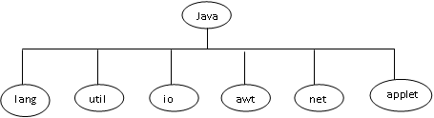
Packages : Java API Packages
Package name | Contents
java.lang | They are automatically imported. They include classes for primitive types, strings, math functions, threads and exceptions
java.util | Language utility classes such as vectors, hash tables, random numbers, date etc.
java.io | They provide facilities for the input and output of data.
java.awt | Set of classes for implementing GUI. They provide classes for windows, button, lists, menus and so on.
java.net | Classes for networking. They include classes for communicating with local computers as well as with internet servers
java.applet | Classes for creating and implementing applets.

Slide 82
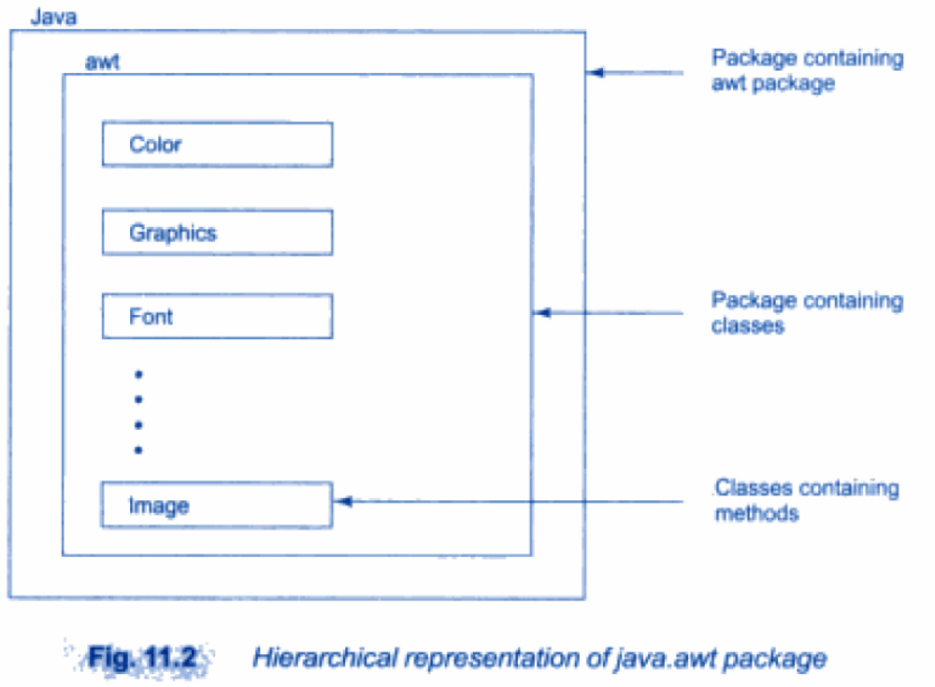

Slide 83
Packages : Java API Packages
Two ways of accessing the classes stored in a package.
  Use the fully qualified class name of the class that we want to use
    Example: java.awt.Color
  Import the package
    Syntax 1: import packagename.classname;
    Syntax 2: import packagename.*;
    Import statements must appear at the top of the file, before any class declarations.
    Example : import java.awt.Color;
    Example: import java.awt.*;
    It brings all classes of java.awt package.
Naming Convention : java.packagename.classname.methodname()
Example : double y=java.lang.Math.sqrt();

Slide 84
Packages : User Defined Packages
Steps to create user defined packeges:
  Declare the package at the beginning of a file using the form :
  package packagename;
  Define the class that is to be put in the package and declare it public
  Create a subdirectory under the directory where the main source files are stored. Subdirectory name must match the package name exactly.
  Store the listing as the classname.java file in the subdirectory created
  Compile the file. This create .class file in the subdirectory

Slide 85
Packages : User Defined Packages
Example: package firstPackage;
public class FirstClass
{
(body of class)
}
This file should be saved as a file called FirstClass.java , and located in a directory named firstPackage under the current working directory.
A Java package file can have more than one class definitions. In such cases, only one of the classes may be declare public and that class name with .java extension is the source file name.
If we omit the package statement, the class names are put into the default package, which has no name.

Slide 86
Packages : User Defined Packages
Java supports the concepts of package hierarchy.
General form : package pkg1[.pkg2[.pkg3]];
Example : package firstPackage.secondPackage;
  Store this package in a subdirctory names firstPackage/secondPackage
Syntax for Accessing a User Defined Package:
import package1[.package2][.package3].classname;
or
import packagename.*;

Slide 87
ClassA.java
PackageTest2.java
package package1; public class ClassA { public void displayA() { System.out.println(“Class A”); } }
import package1.ClassA; import package2.*; class packageTest2 { public static void main(String args[]) { ClassA objectA=new ClassA(); ClassB objectB=new ClassB(); objectA.displayA(); objectB.displayB(); } }
ClassB.java
package package2; public class ClassB { Protected int m=10; public void displayB() { System.out.println(“Class B”); System.out.println(“m=”+m); } }
Output: Class A Class B m=10

Slide 88
Packages : User Defined Packages
When we import multiple packages it is likely that two or more packages contain classes with identical names.
Example:
When we import and use these packages like:
package pack1; public class Student {……………………….}
package pack2; public class Student {……………………….}
import pack1.*; import pack2.*; Student Student1;// error
import pack1.*; import pack2.*; pack1.Student Student1; pack2.Student Student2;
Correct

Slide 89
Packages : User Defined Packages
It is possible to subclass a class that has been imported from another package.
PackageTest3.java
ClassB.java
import package2.ClassB; class ClassC extends ClassB { int n=20; void displayC() { System.out.println(“Class C”); System.out.println(“m=”+m); System.out.println(“n=”+n); } } class PackageTest3 { public static void main(String args[]) { ClassC objectC=new ClassC(); objectC.displayB(); objectC.displayC(); } }
package package2; public class ClassB { protected int m=10; public void displayB() { System.out.println(“Class B”); System.out.println(“m=”+m); } }
Output: Class B m=10 Class C m=10 n=20

Slide 90
Packages : User Defined Packages
If we want to create a package with multiple public classes in it, follow the steps:
  Decide the name of the package
  Create a subdirectory with this name under the directory where the main source files are stored.
  Create classes that are to be placed in the package in separate source files and declare the package statement
  package packagename;
  at the top of each source file
  Switch to the subdirectory created earlier and compile each source file. When compiled, the package would contain .class files of the all source files.

Slide 91
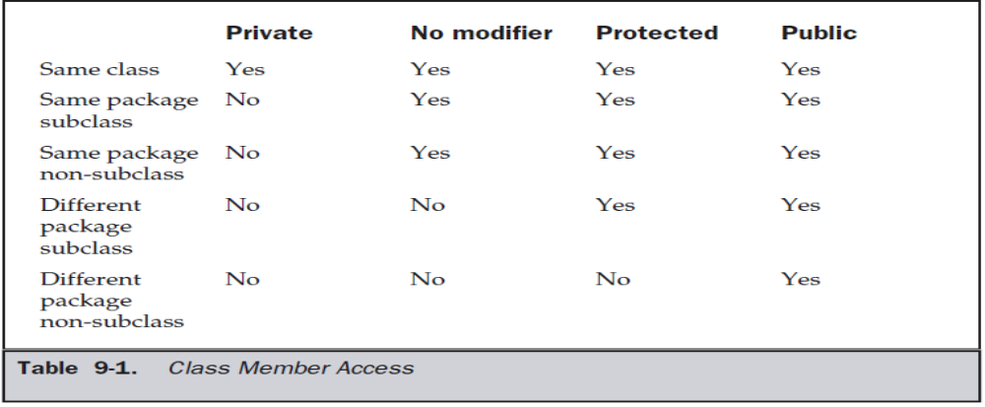
Packages : Access Protection
Private – only within class
Default – it is visible to subclasses as well as to other classes in the same package.
Protected – If you want to allow an element to be seen outside your current package, but only to classes that subclass your class directly, then declare that element protected.
Public – can be accessed from anywhere

Slide 92
package p1; public class Protection { int n = 1; private int n_pri = 2; protected int n_pro = 3; public int n_pub = 4; public Protection() { System.out.println("base constructor"); System.out.println("n = " + n); System.out.println("n_pri = " + n_pri); System.out.println("n_pro = " + n_pro); System.out.println("n_pub = " + n_pub); } }
package p1; class Derived extends Protection { Derived() { System.out.println("derived constructor"); System.out.println("n = " + n); // System.out.println("n_pri = " + n_pri); System.out.println("n_pro = " + n_pro); System.out.println("n_pub = " + n_pub); } }
package p1; class SamePackage { SamePackage() { Protection p = new Protection(); System.out.println("same package constructor"); System.out.println("n = " + p.n); // System.out.println("n_pri = " + p.n_pri); System.out.println("n_pro = " + p.n_pro); System.out.println("n_pub = " + p.n_pub); } }
Protection.java
Derived.java
SamePackage.java

Slide 93
package p2; class Protection2 extends p1.Protection { Protection2() { System.out.println("derived other package constructor"); // System.out.println("n = " + n); // System.out.println("n_pri = " + n_pri); System.out.println("n_pro = " + n_pro); System.out.println("n_pub = " + n_pub); } }
Protection2.java
package p2; class OtherPackage { OtherPackage() { p1.Protection p = new p1.Protection(); System.out.println("other package constructor"); // System.out.println("n = " + p.n); // System.out.println("n_pri = " + p.n_pri); // System.out.println("n_pro = " + p.n_pro); System.out.println("n_pub = " + p.n_pub); } }
OtherPackage.java

Slide 94
Packages : User Defined Packages
When we import a package into a file, all public classes are imported.
To hide few classes from external access, declare those as non public.
Example:
The class Y can be seen and used only by the other classes in the same package.
package p1; public class X { //body of X } class Y { //body of Y }
import p1.*; X objectX; //correct Y objectY; //error. Y is not available

Slide 95
Syllabus
Creating & using classes in Java
  Methods and Classes
Inheritance
  Super Class
  Method Overriding
Packages and Interfaces
  Implementing Interfaces
Exception Handling
  Exception Types
Threads
  Multithreaded programs
    Thread Priorities
    Thread synchronization

Slide 96
Exception Handling
An exception is an abnormal condition that arises in a code sequence at run time.
Type of Errors :
  Compile time errors
    These errors are detected and displayed by the Java compiler
    Most of the compile time errors are due to type mismatch
    Ex: Missing ;, Mismatch of brackets, Misspelling of keywords and identifiers, Missing double quotes in string etc.
  Run time errors
    Such programs may produce wrong results due to wrong logic or may terminate due to errors such as stack overflow.
    Ex: dividing an integer by zero, Accessing an element that is out of the bounds of an array, trying to save an element into an array of incompatible type etc.
    When such errors are encountered, Java generates an error message and aborts the program.

Slide 97
Exception Handling : Exception Types
Throwable is at the top of the exception class hierarchy. Immediately below Throwable are two subclasses :
  Exception
    This class is used for exceptional conditions that user programs should catch.
    Used to create our own custom exception types.
    There is an important subclass of Exception, called RuntimeException. Exceptions of this type are automatically defined for the programs that you write and include things such as division by zero and invalid array indexing.
  Error
    These exceptions are not expected to be caught under normal circumstances by our program.
    These are used by the Java run-time system to indicate errors having to do with the run-time environment
    Ex: Stack overflow

Slide 98
Exception Handling
When an exceptional condition arises, an object representing that exception is created and thrown in the method that caused the error
Exceptions can be generated by
  The Java run-time system : due to the violation of the rules of Java language or constraints of the Java execution environment
  Manually generated by our code

Slide 99
Exception Handling
Uncaught Exceptions are handled by Java runtime system.
class Exc0 { public static void main(String args[]) { int d = 0; int a = 42 / d; } }
Output: java.lang.ArithmeticException: / by zero at Exc0.main(Exc0.java:6)

Slide 100
class Exc1 { static void subroutine() { int d = 0; int a = 10 / d; } public static void main(String args[]) { Exc1.subroutine(); } }
Output: java.lang.ArithmeticException: / by zero at Exc1.subroutine(Exc1.java:6) at Exc1.main(Exc1.java:10)

Slide 101
Exception Handling
Java exception handling is managed via five keywords:
  try : Program statements that we want to monitor for exceptions are contained within a try block.
  throw : To manually throw an exception.
  throws : Any exception that is thrown out of a method must be specified by a throws clause.
  catch : to catch exceptions and handle it in some rational manner.
  finally : Any code that absolutely must be executed before a method returns is put in a finally block.

Slide 102
Exception Handling
General Form :
try { // block of code to monitor for errors } catch (ExceptionType1 exOb) { // exception handler for ExceptionType1 } catch (ExceptionType2 exOb) { // exception handler for ExceptionType2 } // ... finally { // block of code to be executed before try block ends }
ExceptionType is the type of exception that has occurred.

Slide 103
Exception Handling : try and catch
class Exc2 { public static void main(String args[]) { int d, a; try // monitor a block of code. { d = 0; a = 42 / d; System.out.println("This will not be printed."); } catch (ArithmeticException e) { System.out.println("Division by zero."); } System.out.println("After catch statement."); } }
Output: Division by zero. After catch statement.

Slide 104
Exception Handling : try and catch
Enclose the code that we want to monitor inside a try block.
Immediately following the try block, include a catch clause that specifies the exception type that we wish to catch.
Once an exception is thrown, program control transfers out of the try block into the catch block. Execution never returns to the try block from a catch.
Once the catch statement has executed, program control continues with the next line in the program following the entire try/catch mechanism

Slide 105
Exception Handling : Multiple catch clauses
class MultiCatch { public static void main(String args[]) { try { int a = args.length; System.out.println("a = " + a); int b = 42 / a; int c[] = { 1 }; c[42] = 99; } catch(ArithmeticException e) { System.out.println("Divide by 0: " + e); } catch(ArrayIndexOutOfBoundsException e) { System.out.println("Array index oob: " + e); } System.out.println("After try/catch blocks."); } }
More than one exception could be raised by a single piece of code.
To handle this type of situation, we can specify two or more catch clauses, each catching a different type of exception.
When an exception is thrown, each catch statement is inspected in order, and the first one whose type matches that of the exception is executed.
After one catch statement executes, the others are bypassed, and execution continues after the try/catch block.

Slide 106
Exception Handling : Multiple catch clauses
class SuperSubCatch { public static void main(String args[]) { try { int a = 0; int b = 42 / a; } catch(Exception e) { System.out.println("Generic Exception “); } /*/This catch is never reached catch(ArithmeticException e) { // ERROR – unreachable System.out.println(“Never reached."); } } }
The exception subclasses must come before any of their superclasses.

Slide 107
Exception Handling : nested try
A try statement can be inside the block of another try.
Each time a try statement is entered, the context of that exception is pushed on the stack.
If an inner try statement does not have a catch handler for a particular exception, the stack is unwound and the next try statement’s catch handlers are inspected for a match.
This continues until one of the catch statements succeeds, or until all of the nested try statements are exhausted.
If no catch statement matches, then the Java run-time system will handle the exception.

Slide 108
class NestTry { public static void main(String args[]) { try { int a = args.length; int b = 42 / a; // no command-line args, generate a divide-by-zero exception. System.out.println("a = " + a); try // nested try block { if(a==1) a = a/(a-a); // 1 cmd-line arg, generate a divide-by-zero exception if(a==2) { int c[] = { 1 }; c [42] = 99; // generate an out-of-bounds exception } } catch(ArrayIndexOutOfBoundsException e) { System.out.println("Array index out-of-bounds: " + e); } } catch(ArithmeticException e) { System.out.println("Divide by 0: " + e); } } }

Slide 109
Exception Handling : Implicitly nested try
class MethNestTry { static void nesttry(int a) { try // implicitly nested try block { if(a==1) a = a/(a-a); // division by zero if(a==2) { int c[] = { 1 }; c[42] = 99; // generate an out-of-bounds exception } } catch(ArrayIndexOutOfBoundsException e) { System.out.println("Array index out-of-bounds: " + e); } } public static void main(String args[]) { try { int a = args.length; int b = 42 / a; System.out.println("a = " + a); nesttry(a); } catch(ArithmeticException e) { System.out.println("Divide by 0: " + e); } } }

Slide 110
Exception Handling : throw
To throw an exception explicitly
Syntax : throw ThrowableInstance;
  ThrowableInstance is an object of type Throwable or a subclass of Throwable.
The flow of execution stops immediately after the throw statement.
The nearest enclosing try block is inspected to see if it has a catch statement that matches the type of the exception.
  If it does find a match, control is transferred to that statement.
  If not, then the next enclosing try statement is inspected, and so on.
  If no matching catch is found, then the default exception handler halts the program and prints the stack trace.

Slide 111
class ThrowDemo { static void demoproc() { try { throw new NullPointerException("demo"); } catch(NullPointerException e) { System.out.println("Caught inside demoproc."); throw e; // rethrow the exception } } public static void main(String args[]) { try { demoproc(); } catch(NullPointerException e) { System.out.println("Recaught: " + e); } } }
Unchecked Exception
Output: Caught inside demoproc. Recaught:java.lang.NullPointerException: demo

Slide 112
Exception Handling : throws
A throws clause lists the types of exceptions that a method might throw.
All exceptions (except those of type Error or RuntimeException, or any of their subclasses) that a method can throw must be declared in the throws clause.
Syntax :
  type method-name(parameter-list) throws exception-list
  {
  // body of method
  }

Slide 113
Exception Handling : throws
This program contains an error and will not compile.
class ThrowsDemo { static void throwOne() { System.out.println("Inside throwOne."); throw new IllegalAccessException("demo"); } public static void main(String args[]) { throwOne(); } }
Checked Exception

Slide 114
class ThrowsDemo { static void throwOne() throws IllegalAccessException { System.out.println("Inside throwOne."); throw new IllegalAccessException("demo"); } public static void main(String args[]) { try { throwOne(); } catch (IllegalAccessException e) { System.out.println("Caught " + e); } } }
Output: inside throwOne caught java.lang.IllegalAccessException: demo

Slide 115
Exception Handling : finally
finally creates a block of code that will be executed after a try/catch block has completed.
finally block is used to handle any exception generated within a try block which is not caught by any of the previous catch statements.
The finally block will execute whether or not an exception is thrown.
If an exception is thrown, the finally block will execute even if no catch statement matches the exception.
Any time a method is about to return to the caller from inside a try/catch block, the finally clause is also executed just before the method returns.
The finally clause is optional. However, each try statement requires at least one catch or a finally clause.

Slide 116
Exception Handling : finally
Syntax :
try { ……………… } finally { …………….. }
try { ……………… } catch(){……………} catch(){……………} catch(){……………} . . finally { …………….. }

Slide 117
class FinallyDemo { // Through an exception out of the method. static void procA() { try { System.out.println("inside procA"); throw new RuntimeException("demo"); } finally { System.out.println("procA's finally"); } } // Return from within a try block. static void procB() { try { System.out.println("inside procB"); return; } finally {System.out.println("procB's finally"); } }
// Execute a try block normally. static void procC() { try { System.out.println("inside procC"); } finally { System.out.println("procC's finally"); } } public static void main(String args[]) { try { procA(); } catch (Exception e) { System.out.println("Exception caught"); } procB(); procC(); } }
Output : inside procA procA’s finally Exception caught inside procB procB’s finally inside procC procC’s finally

Slide 118
Exception Handling : Built in Exceptions
java.lang, package contains several exception classes.
Two types of exceptions:
  Unchecked exceptions
    Since java.lang is implicitly imported into all Java programs, most exceptions derived from RuntimeException are automatically available.
    They need not be included in any method’s throws list.
    The compiler does not check to see if a method handles or throws these exceptions.
  Checked exceptions :
    Some exceptions are defined by java.lang that must be included in a method’s throws list if that method can generate one of these exceptions and does not handle it itself.

Slide 119
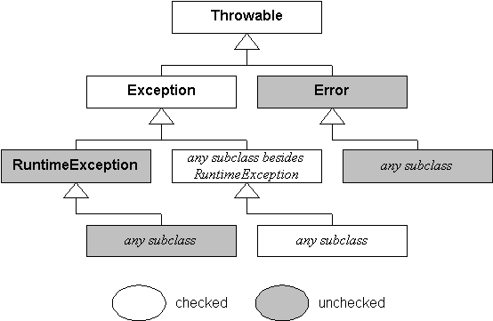

Slide 120
Java’s Unchecked RuntimeException Subclasses
Exception | Meaning
ArithmeticException | Arithmetic error, such as divide-by-zero.
ArrayIndexOutOfBoundsException | Array index is out-of-bounds.
ArrayStoreException | Assignment to an array element of an incompatible type.
ClassCastException | Invalid cast.
IllegalArgumentException | Illegal argument used to invoke a method.
IllegalMonitorStateException | Illegal monitor operation, such as waiting on an unlocked thread.
IllegalStateException | Environment or application is in incorrect state.
IllegalThreadStateException | Requested operation not compatible with current thread state.
IndexOutOfBoundsException | Some type of index is out-of-bounds.
NegativeArraySizeException | Array created with a negative size.
NullPointerException | Invalid use of a null reference.
NumberFormatException | Invalid conversion of a string to a numeric format.
SecurityException | Attempt to violate security.
StringIndexOutOfBounds | Attempt to index outside the bounds of a string.
UnsupportedOperationException | An unsupported operation was encountered.

Slide 121
Java’s Checked Exception Subclasses
Exception | Meaning
ClassNotFoundException | Class not found.
CloneNotSupportedException | Attempt to clone an object that does not implement the Cloneable interface.
IllegalAccessException | Access to a class is denied.
InstantiationException | Attempt to create an object of an abstract class or interface.
InterruptedException | One thread has been interrupted by another thread.
NoSuchFieldException | A requested field does not exist.
NoSuchMethodException | A requested method does not exist.

Slide 122
Exception Handling : User Defined Exceptions
class MyException extends Exception { private int detail; MyException(int a) { detail = a; } public String toString() { return "MyException[" + detail + "]"; } }
class ExceptionDemo { static void compute(int a) throws MyException { System.out.println("Called compute(" + a + ")"); if(a > 10) throw new MyException(a); System.out.println("Normal exit"); } public static void main(String args[]) { try { compute(1); compute(20); } catch (MyException e) {System.out.println("Caught " + e); } } }
Output : Called compute(1) Normal exit Called compute(20) Caught MyException[20]

Slide 123
Syllabus
Creating & using classes in Java
  Methods and Classes
Inheritance
  Super Class
  Method Overriding
Packages and Interfaces
  Implementing Interfaces
Exception Handling
  Exception Types
Threads
  Multithreaded programs
    Thread Priorities
    Thread synchronization

Slide 124
Multithreading
A multithreaded program contains two or more parts that can run concurrently.
Each part of such a program is called a thread
Each thread defines a separate path of execution
Two types of multitasking:
  Process-based
    A process is a program that is executing.
    Process-based multitasking allows our computer to run two or more programs concurrently
    Example: can use a Java compiler and a text editor simultaneously.
  Thread-based
    A single program can perform two or more tasks simultaneously
    Example : A text editor can format text at the same time that it is printing

Slide 125
Multithreading
Disadvantages of multitasking processes :
  More overhead than Multitasking threads.
  Processes are heavyweight tasks
  Processes requires their own separate address spaces.
  Interprocess communication is expensive and limited.
  Context switching from one process to another is also costly.
Advantages of multithreaded programs :
  Threads are lightweight
  They share the same address space
  Interthread communication is inexpensive
  Context switching from one thread to the next is low cost.
Java supports multithreaded multitasking.
Every thread in Java is created and controlled by the java.lang.Thread class

Slide 126
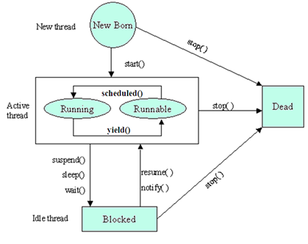
Thread Life Cycle

Slide 127
Thread Life Cycle
Newborn state :
  When we create a thread object, the thread is born and is said to be in newborn state.
  This thread is not yet scheduled for running
  If we attempt to use any other method at this state, an exception will be thrown.
  The following things can be done at this state:
    Schedule it for running using start() : it moves to the runnable state
    Kill it using stop()

Slide 128
Thread Life Cycle
Runnable State
  The thread is ready for execution and is waiting for the availability of the processor
  The thread has joined the queue of threads that are waiting for execution.
  If all threads have equal priority, then they are given time slots for execution in round robin fashion.
  The thread that relinquishes control joins the queue at the end and again waiting for its turn.

Slide 129
Thread Life Cycle
Running State
  The processor has given its time to the thread for its execution.
  The thread runs until it relinquishes control on its own or it is preempted by a higher priority thread.
  A running thread relinquish its control in one of the following situations
    It has been suspended using suspend(). A suspend thread can be revived by using the resume().
    We can put a thread to sleep for a specified time period using the method sleep(time) where time is in milliseconds. The thread re-enters the runnable state as soon as this time period is elapsed.
    It has been told to wait until some event occurs. This is done using the wait(). The thread can be scheduled to run again using the notify().

Slide 130
Thread Life Cycle
Blocked State
  A thread is prevented from entering into the runnable state and subsequently the running state
  This happens when the thread is suspended, sleeping, or waiting in order to satisfy certain requirements
Dead State
  Natural death : A running thread ends its life when it has completed executing its run().
  Premature death : We can kill a thread by sending the stop message to it at any state
  A thread can be killed as soon as it is born, or while it is running, or even when it is in blocked condition.
  At any time, a thread can be terminated, which halts its execution immediately. Once terminated, a thread cannot be resumed.

Slide 131
Thread Class and runnable Interface
Java’s multithreading system is built upon the Thread class and Runnable interface.
The Thread class defines several methods that help manage threads
Method | Meaning
getName | Obtain a thread’s name
getPriority | Obtain a thread’s priority
isAlive | Determine if a thread is still running
join | Wait for a thread to terminate
run | Entry point for the thread
sleep | Suspend a thread for a period of time
start | Start a thread by calling its run method

Slide 132
Main Thread
When a Java program starts up, main thread begins running immediately.
It is the thread from which other “child” threads will be spawned.
It must be the last thread to finish execution
Current thread object is obtained by calling the method currentThread( ).
General form:
static Thread currentThread( )

Slide 133
class CurrentThreadDemo { public static void main(String args[]) { Thread t = Thread.currentThread(); System.out.println("Current thread: " + t); t.setName(“S6 CSE"); System.out.println("After name change: " + t); try {System.out.println(“I’m going to sleep like u”); for(int n = 5; n > 0; n--) { System.out.println(n); Thread.sleep(1000); } } catch (InterruptedException e) { System.out.println("Main thread interrupted"); } } }
Output : Current thread: Thread[main,5,main] After name change: Thread[S6 CSE,5,main] I’m going to sleep like u 5 4 3 2 1
[main,5,main] :
The 1st main is the name of the
thread
5 is the default priority
2nd main is the name of the
group of threads to which this
thread belongs.

Slide 134
Main Thread
sleep( ) Syntax :
  static void sleep(long milliseconds) throws InterruptedException
  static void sleep(long milliseconds, int nanoseconds) throws
  InterruptedException
  The number of milliseconds to suspend is specified in milliseconds and the number of nanoseconds to suspend is specified in nanoseconds.
setName( ) and getName( ) Syntax:
  final void setName(String threadName)
  final String getName( )
  Here, threadName specifies the name of the thread.

Slide 135
Creating a Thread
To create a Thread, Java adopts the following two ways :
  By implementing the Runnable interface
  By extending the Thread class

Slide 136
Creating a Thread : implementing Runnable
Interface
The thread class should implements Runnable interface.
Thread class need to implement a single method called run().
Syntax : public void run( )
  Inside run( ), we can define the code that constitutes the new thread.
  run( ) can call other methods, use other classes, and declare variables, just like the main thread can.
  This thread will end when run( ) returns.

Slide 137
Creating a Thread : implementing Runnable
Interface
Instantiate an object of type Thread within that class.
Thread defines several constructors.
Eg : Thread(Runnable threadOb, String threadName)
threadOb is an instance of a class that implements the Runnable interface.
threadName is the name of the new thread
After the new thread is created, call start( ) method to begin execution of the thread.
start() is declared within Thread.
Syntax : void start( )

Slide 138
class NewThread implements Runnable { Thread t; NewThread() { t = new Thread(this, "Demo Thread"); System.out.println("Child thread: " + t); t.start(); } public void run() { try { for(int i = 5; i > 0; i--) { System.out.println("Child Thread:" + i); Thread.sleep(500); } } catch (InterruptedException e) { System.out.println("Child interrupted."); } System.out.println("Exiting child thread”); } }
class ThreadDemo { public static void main(String args[]) { new NewThread(); try { for(int i = 5; i > 0; i--) { System.out.println("Main Thread:" + i); Thread.sleep(1000); } } catch (InterruptedException e) { System.out.println(“Interrupted."); } System.out.println("Main thread exiting."); } }
Output : Child thread: Thread[Demo Thread,5,main] Main Thread: 5 Child Thread: 5 Child Thread: 4 Main Thread: 4 Child Thread: 3
Child Thread: 2 Main Thread: 3 Child Thread: 1 Exiting child thread. Main Thread: 2 Main Thread: 1 Main thread exiting.

Slide 139
Creating a Thread : Extending Thread Class
Create a new class that extends Thread
The extending class must override the run( ) method
It must also call start( ) to begin execution of the new thread.
Then create an instance of the extending class.

Slide 140
class NewThread extends Thread { NewThread() { super("Demo Thread"); System.out.println("Child thread: " + this); start(); } public void run() { try { for(int i = 5; i > 0; i--) { System.out.println("Child Thread: " + i); Thread.sleep(500); } } catch (InterruptedException e) { System.out.println("Child interrupted."); } System.out.println("Exiting child thread."); } }
class ExtendThread { public static void main(String args[]) { new NewThread(); try { for(int i = 5; i > 0; i--) { System.out.println("Main Thread:" + i); Thread.sleep(1000); } } catch (InterruptedException e) { System.out.println("Main Thread interrupted"); } System.out.println("Main Thread exiting."); } }
Output : Child thread: Thread[Demo Thread,5,main] Main Thread: 5 Child Thread: 5 Child Thread: 4 Main Thread: 4 Child Thread: 3
Child Thread: 2 Main Thread: 3 Child Thread: 1 Exiting child thread. Main Thread: 2 Main Thread: 1 Main thread exiting.

Slide 141
Creating Multiple Threads
class NewThread implements Runnable { String name; Thread t; NewThread(String threadname) { name = threadname; t = new Thread(this, name); System.out.println("New thread: " + t); t.start(); } public void run() { try { for(int i = 5; i > 0; i--) { System.out.println(name + ": " + i); Thread.sleep(1000); } } catch (InterruptedException e) {System.out.println(name + "Interrupted"); } System.out.println(name + " exiting."); } }
class MultiThreadDemo { public static void main(String args[]) { new NewThread("One"); new NewThread("Two"); new NewThread("Three"); try { Thread.sleep(10000); } catch (InterruptedException e) { System.out.println("Main thread Interrupted"); } System.out.println("Main thread exiting."); } }
Output : New thread: Thread[One,5,main] New thread: Thread[Two,5,main] New thread: Thread[Three,5,main] One: 5 Two: 5 Three: 5 One: 4 Two: 4 Three: 4
One: 3 Three: 3 Two: 3 One: 2 Three: 2 Two: 2 One: 1 Three: 1 Two: 1
One exiting. Two exiting. Three exiting. Main thread exiting.

Slide 142
Thread : isAlive(), join()
Java provides two ways to determine whether a thread has finished.
  isAlive( )
    This method is defined by Thread
    General form : final boolean isAlive( )
    This method returns true if the thread is still running. Otherwise it returns false.
  join( )
    General form : final void join( ) throws InterruptedException
    This method waits until the thread on which it is called terminates.

Slide 143
class NewThread implements Runnable { String name; Thread t; NewThread(String threadname) { name = threadname; t = new Thread(this, name); System.out.println("New thread: " + t); t.start(); // Start the thread } public void run() { try { for(int i = 5; i > 0; i--) { System.out.println(name + ": " + i); Thread.sleep(1000); } } catch (InterruptedException e) { System.out.println(name + " interrupted"); } System.out.println(name + " exiting."); } }
class DemoJoin { public static void main(String args[]) { NewThread ob1 = new NewThread("One"); NewThread ob2 = new NewThread("Two"); NewThread ob3 = new NewThread("Three"); System.out.println(“1 alive: " + ob1.t.isAlive()); System.out.println(“2 alive: " + ob2.t.isAlive()); System.out.println(“3 alive: " + ob3.t.isAlive()); try {System.out.println("Waiting to finish."); ob1.t.join(); ob2.t.join(); ob3.t.join(); } catch (InterruptedException e) { System.out.println("Main thread Interrupted"); } System.out.println(“1 alive: " + ob1.t.isAlive()); System.out.println(“2 alive: " + ob2.t.isAlive()); System.out.println(“3 alive: " + ob3.t.isAlive()); System.out.println("Main thread exiting."); } }

Slide 144
Output : New thread: Thread[One,5,main] New thread: Thread[Two,5,main] New thread: Thread[Three,5,main] 1alive: true 2 alive: true 3 alive: true Waiting for threads to finish. One: 5 Two: 5 Three: 5 One: 4 Two: 4 Three: 4 One: 3 Two: 3 Three: 3 One: 2 Two: 2 Three: 2 One: 1 Two: 1 Three: 1
Two exiting. Three exiting. One exiting. 1 alive: false 2 alive: false 3 alive: false Main thread exiting.

Slide 145
Thread Priorities
Each thread is assigned a priority
Thread priorities are integer values
Thread priority determines how that thread should be treated with respect to the others.
A thread’s priority is used for context switch.
Rules for context switch :
  A thread can voluntarily relinquish control
    All other threads are examined, and the highest-priority thread that is ready to run is given the CPU.
  A thread can be preempted by a higher-priority thread.
    As soon as a higher-priority thread wants to run, it does. This is called preemptive multitasking.

Slide 146
Thread Priorities
Higher-priority threads get more CPU time than lower priority threads.
Threads of equal priority should get equal access to the CPU.
setPriority( ) : To set a thread’s priority, which is a member of Thread.
  General form: final void setPriority(int level)
The value of level must be within the range MIN_PRIORITY and MAX_PRIORITY (1 -10).
NORM_PRIORITY is the default priority (5)
getPriority( ) : obtain the current priority of a Thread
  General Form : final int getPriority( )

Slide 147
class clicker implements Runnable { int click = 0; Thread t; private volatile boolean running = true; public clicker(int p) { t = new Thread(this); t.setPriority(p); } public void run() { while (running) { click++; } } public void stop() { running = false; } public void start() { t.start(); } }
class HiLoPri { public static void main(String args[]) { Thread.currentThread().setPriority(Thread.MAX_PRIORITY); clicker hi = new clicker(Thread.NORM_PRIORITY + 2); clicker lo = new clicker(Thread.NORM_PRIORITY - 2); lo.start(); hi.start(); try { Thread.sleep(10000); } catch (InterruptedException e) { System.out.println("Main thread interrupted."); } lo.stop(); hi.stop(); try { hi.t.join(); lo.t.join(); } catch (InterruptedException e) { System.out.println("InterruptedException caught"); } System.out.println("Low-priority thread: " + lo.click); System.out.println("High-priority thread: " + hi.click); } }
Output : Low-priority thread: 4408112 High-priority thread: 589626904

Slide 148
Synchronization
When two or more threads need access to a shared resource, they need some way to ensure that the resource will be used by only one thread at a time.
The process by which this is achieved is called synchronization.
Key to synchronization is the concept of the monitor (also called a semaphore).
  A monitor is an object that is used as a mutually exclusive lock, or mutex.
  Only one thread can own a monitor at a given time.
  All other threads attempting to enter the locked monitor will be suspended until the first thread exits the monitor.
  These other threads are said to be waiting for the monitor.
Synchronization can be achieved in two ways
  Using synchronized method
  Using synchronized statements

Slide 149
Synchronization : Synchronized Method
In Java all objects have their own implicit monitor associated with them.
To enter an object’s monitor, just call a method that has been modified with the synchronized keyword.
While a thread is inside a synchronized method, all other threads that try to call it on the same instance have to wait.

Slide 150
class Callme { void call(String msg) { System.out.print("[" + msg); try { Thread.sleep(1000); } catch(InterruptedException e) { System.out.println("Interrupted"); } System.out.println("]"); } } class Caller implements Runnable { String msg; Callme target; Thread t; public Caller(Callme targ, String s) { target = targ; msg = s; t = new Thread(this); t.start(); } public void run() { target.call(msg); } }
class Synch { public static void main(String args[]) { Callme target = new Callme(); Caller ob1 = new Caller(target, "Hello"); Caller ob2 = new Caller(target, "Synchronized"); Caller ob3 = new Caller(target, "World"); try { ob1.t.join(); ob2.t.join(); ob3.t.join(); } catch(InterruptedException e) { System.out.println("Interrupted"); } } }
Output : [Hello[Synchronized[World ] ] ]

Slide 151
class Callme { synchronized void call(String msg) { System.out.print("[" + msg); try { Thread.sleep(1000); } catch(InterruptedException e) { System.out.println("Interrupted"); } System.out.println("]"); } } class Caller implements Runnable { String msg; Callme target; Thread t; public Caller(Callme targ, String s) { target = targ; msg = s; t = new Thread(this); t.start(); } public void run() { target.call(msg); } }
class Synch { public static void main(String args[]) { Callme target = new Callme(); Caller ob1 = new Caller(target, "Hello"); Caller ob2 = new Caller(target, "Synchronized"); Caller ob3 = new Caller(target, "World"); try { ob1.t.join(); ob2.t.join(); ob3.t.join(); } catch(InterruptedException e) { System.out.println("Interrupted"); } } }
Output : [Hello] [Synchronized] [World]

Slide 152
Synchronization : Synchronized Statement
Imagine that we want to synchronize access to objects of a class that was not designed for multithreaded access.
This class was not created by us, but by a third party, and we do not have access to the source code.
Thus, we can’t add synchronized to the appropriate methods within the class.
Solution : put calls to the methods defined by this class inside a synchronized block.
General form :
  synchronized(object)
  {
  // statements to be synchronized
  }
Here, object is a reference to the object being synchronized.

Slide 153
class Callme { void call(String msg) { System.out.print("[" + msg); try { Thread.sleep(1000); } catch(InterruptedException e) { System.out.println("Interrupted"); } System.out.println("]"); } } class Caller implements Runnable { String msg; Callme target; Thread t; public Caller(Callme targ, String s) { target = targ; msg = s; t = new Thread(this); t.start(); } public void run() { Synchronized(target) { target.call(msg); } } }
class Synch { public static void main(String args[]) { Callme target = new Callme(); Caller ob1 = new Caller(target, "Hello"); Caller ob2 = new Caller(target, "Synchronized"); Caller ob3 = new Caller(target, "World"); try { ob1.t.join(); ob2.t.join(); ob3.t.join(); } catch(InterruptedException e) { System.out.println("Interrupted"); } } }
Output : [Hello] [Synchronized] [World]

Slide 154
Interthread Communication
Polling is usually implemented by a loop that is used to check some condition repeatedly.
Once the condition is true, appropriate action is taken.
This wastes CPU time.
  Example : queuing problem
    One thread is producing some data and another is consuming it.
    Suppose that the producer has to wait until the consumer is finished before it generates more data.
    In a polling system, the consumer would waste many CPU cycles while it waited for the producer to produce. Once the producer was finished, it would start polling, wasting more CPU cycles waiting for the consumer to finish, and so on.

Slide 155
Interthread Communication
Java includes an interprocess communication mechanism via:
  wait( ) tells the calling thread to give up the monitor and go to sleep until some other thread enters the same monitor and calls notify( ).
  final void wait( ) throws InterruptedException
  notify( ) wakes up the first thread that called wait( ) on the same object.
  final void notify( )
  notifyAll( ) wakes up all the threads that called wait( ) on the same object. The highest priority thread will run first.
  final void notifyAll( )

Slide 156
//Incorrect Code for producer –consumer problem. class Q { int n; synchronized int get() { System.out.println("Got: " + n); return n; } synchronized void put(int n) { this.n = n; System.out.println("Put: " + n); } } class Producer implements Runnable { Q q; Producer(Q q) { this.q = q; new Thread(this, "Producer").start(); } public void run() { int i = 0; while(true) { q.put(i++); } } }
class Consumer implements Runnable { Q q; Consumer(Q q) { this.q = q; new Thread(this, "Consumer").start(); } public void run() { while(true) { q.get(); } } } class PC { public static void main(String args[]) { Q q = new Q(); new Producer(q); new Consumer(q); System.out.println("Press Control-C to stop."); } }
Output : Put: 1 Got: 1 Got: 1 Got: 1
Got: 1 Got: 1 Put: 2 Put: 3 Put: 4
Put: 5 Put: 6 Put: 7 Got: 7

Slide 157
// A correct code for a producer –consumer problm class Q { int n; boolean valueSet = false; synchronized int get() { if(!valueSet) try { wait(); } catch(InterruptedException e) { System.out.println("InterruptedException caught"); } System.out.println("Got: " + n); valueSet = false; notify(); return n; }
synchronized void put(int n) { if(valueSet) try { wait(); } catch(InterruptedException e) { System.out.println("InterruptedException caught"); } this.n = n; valueSet = true; System.out.println("Put: " + n); notify(); } }

Slide 158
class Producer implements Runnable { Q q; Producer(Q q) { this.q = q; new Thread(this, "Producer").start(); } public void run() { int i = 0; while(true) { q.put(i++); } } } class Consumer implements Runnable { Q q; Consumer(Q q) { this.q = q; new Thread(this, "Consumer").start(); } public void run() { while(true) { q.get(); } } }
class PCFixed { public static void main(String args[]) { Q q = new Q(); new Producer(q); new Consumer(q); System.out.println("Press Control-C to stop."); } }
Output : Put: 1 Got: 1 Put: 2 Got: 2 Put: 3 Got: 3 Put: 4 Got: 4 Put: 5 Got: 5

Slide 159
Deadlock
Deadlock occurs when two threads have a circular dependency on a pair of synchronized objects.
Example :
  Suppose one thread enters the monitor on object X and another thread enters the monitor on object Y.
  If the thread in X tries to call any synchronized method on Y, it will block.
  However, if the thread in Y, in turn, tries to call any synchronized method on X, the thread waits forever.

Slide 160
class A { synchronized void foo(B b) { String name = Thread.currentThread().getName(); System.out.println(name + " entered A.foo"); try { Thread.sleep(1000); } catch(Exception e) { System.out.println("A Interrupted"); } System.out.println(name + " trying to call B.last()"); b.last(); } synchronized void last() { System.out.println("Inside A.last"); } }
class B { synchronized void bar(A a) { String name = Thread.currentThread().getName(); System.out.println(name + " entered B.bar"); try { Thread.sleep(1000); } catch(Exception e) { System.out.println("B Interrupted"); } System.out.println(name + " trying to call A.last()"); a.last(); } synchronized void last() { System.out.println("Inside A.last"); } }

Slide 161
class Deadlock implements Runnable { A a = new A(); B b = new B(); Deadlock() { Thread.currentThread().setName("MainThread"); Thread t = new Thread(this, "RacingThread"); t.start(); a.foo(b); // get lock on a in this thread. System.out.println("Back in main thread"); } public void run() { b.bar(a); // get lock on b in other thread. System.out.println("Back in other thread"); } public static void main(String args[]) { new Deadlock(); } }
Output : MainThread entered A.foo RacingThread entered B.bar MainThread trying to call B.last() RacingThread trying to call A.last() Then the system deadlocked

Slide 162
Suspending, Resuming, and Stopping Threads in Java1.1 and Earlier
final void suspend( )
final void resume( )
final void stop( )
Once a thread has been stopped, it cannot be restarted using resume( ).

Slide 163
class NewThread implements Runnable { String name; // name of thread Thread t; NewThread(String threadname) { name = threadname; t = new Thread(this, name); System.out.println("New thread: " + t); t.start(); // Start the thread } public void run() { try { for(int i = 15; i > 0; i--) {System.out.println(name + ": " + i); Thread.sleep(200); } } catch (InterruptedException e) {System.out.println(name + " interuptd"); } System.out.println(name + " exiting."); } }

Slide 164
class SuspendResume { public static void main(String args[]) { NewThread ob1 = new NewThread("One"); NewThread ob2 = new NewThread("Two"); try { Thread.sleep(1000); ob1.t.suspend(); System.out.println("Suspending thread One"); Thread.sleep(1000); ob1.t.resume(); System.out.println("Resuming thread One"); ob2.t.suspend(); System.out.println("Suspending thread Two"); Thread.sleep(1000); ob2.t.resume(); System.out.println("Resuming thread Two"); } catch (InterruptedException e) { System.out.println("Main thread Interrupted"); }
try { System.out.println("Waiting for threads to finish."); ob1.t.join(); ob2.t.join(); } catch (InterruptedException e) { System.out.println("Main thread Interrupted"); } System.out.println("Main thread exiting."); } }

Slide 165
Output : New thread: Thread[One,5,main] One: 15 New thread: Thread[Two,5,main] Two: 15 One: 14 Two: 14 One: 13 Two: 13 One: 12 Two: 12 One: 11 Two: 11 Suspending thread One Two: 10 Two: 9 Two: 8 Two: 7 Two: 6 Resuming thread One Suspending thread Two One: 10 One: 9 One: 8 One: 7 One: 6
Resuming thread Two Waiting for threads to finish. Two: 5 One: 5 Two: 4 One: 4 Two: 3 One: 3 Two: 2 One: 2 Two: 1 One: 1 Two exiting. One exiting. Main thread exiting.

